Slide 1

PREDICTION OF HEART DISEASE USING DATA MINING TECHNIQUES
CSE D
By
M. Sindhu AP19110010037
B. Meghana AP19110010067
M. Pavitra AP19110010075
M. Reshma Sri AP19110010089
K. Rohith AP19110010098

Slide 2
Contents
Introduction
Types of heart disease
Data set Description
Results
Conclusion

Slide 3
Introduction
The use of data mining in healthcare is growing increasingly popular.
Many factors, such as cholesterol level, blood pressure, smoking habits, pulse rate, age, diabetes, and more, contribute to heart disease.
Various Machine Learning models such as K- Nearest Neighbor, Naive Bayes, Decision Tree, Linear Regression, and Support Vector Machine are used.
Aims to determine the aspects of using healthcare data for the benefit of people by implementing methods of machine learning in combination with data mining.

Slide 4
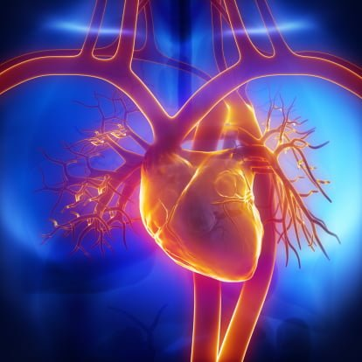
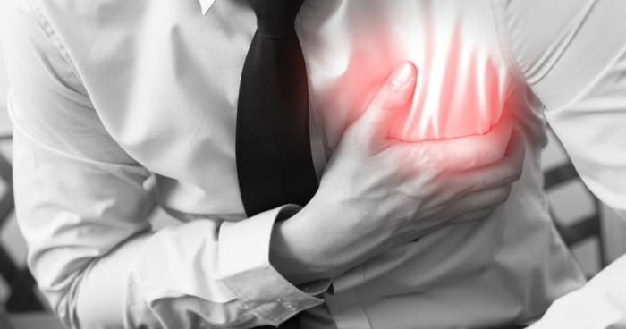
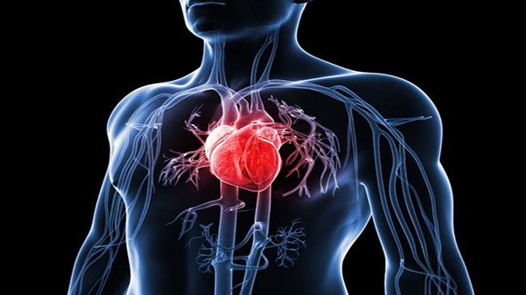
Types of Heart Disease
Coronary illness
Angina pectoris
Congestive heart disappointment
Cardiomyopathy
Innate coronary illness
Arrhythmias
Myocarditis

Slide 5
Data Set Description
S. No | Attributes | Values | Description
1 | age | 29-77 | age in years
2 | sex | 0-male, 1-female | gender
3 | cp | 0 - asymptomatic; 1-typical angina; 2-atypical angina 3-non-anginal pain; | chest pain type
4 | trestbps | Numeric value(140mm/Hg) | resting blood pressure in mm/Hg
5 | chol | Numeric value(289mg/dl) | serum cholesterol in mg/dl
6 | fbs | 1-true, 0-false | fasting blood pressure>120mg/dl
7 | restecg | 0-normal, 1-having ST-T, 2-hypertrophy | resting electrocardiographic results
8 | thalach | 140,173 | maximum heart rate achieved
9 | exang | 1-yes, 0-no | exercise induced angina
10 | oldpeak | Numeric value | ST depression induced by exercise relative to rest
11 | slope | 1-upsloping, 2-flat, 3-downsloping | the slope of the peak exercise ST segment
12 | ca | 0-3 vessels | number of major vessels coloured by fluoroscopy
13 | thal | 0: < 50% diameter narrowing 1: > 50% diameter narrowing | thalassemia
14 | target | 1 = no, 0= yes | diagnosis of heart disease (angiographic disease status)

Slide 6
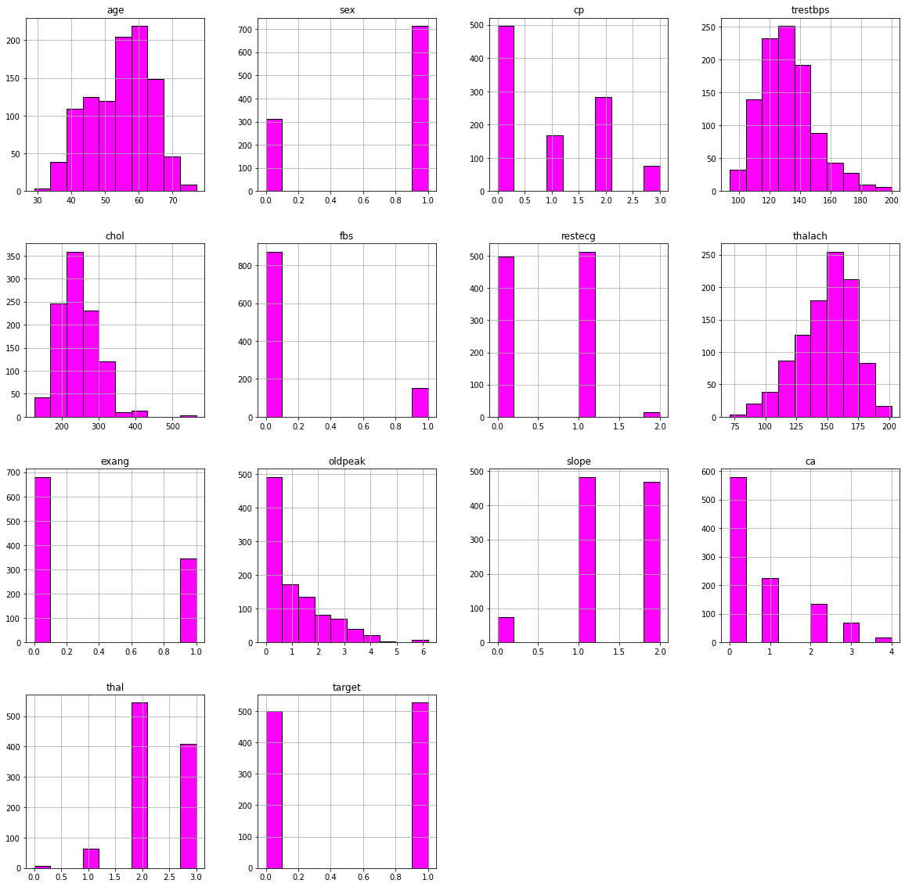
Results
Histogram for every attribute:

Slide 7
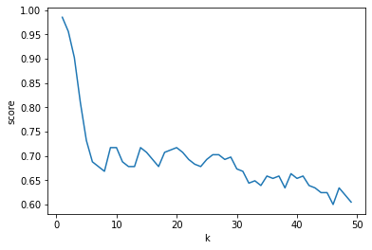
K-score for 50 Neighbours

Slide 8
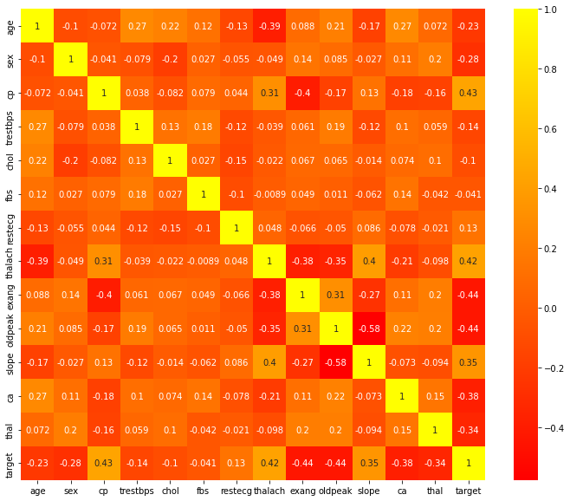
Correlation Matrix for every attribute:

Slide 9
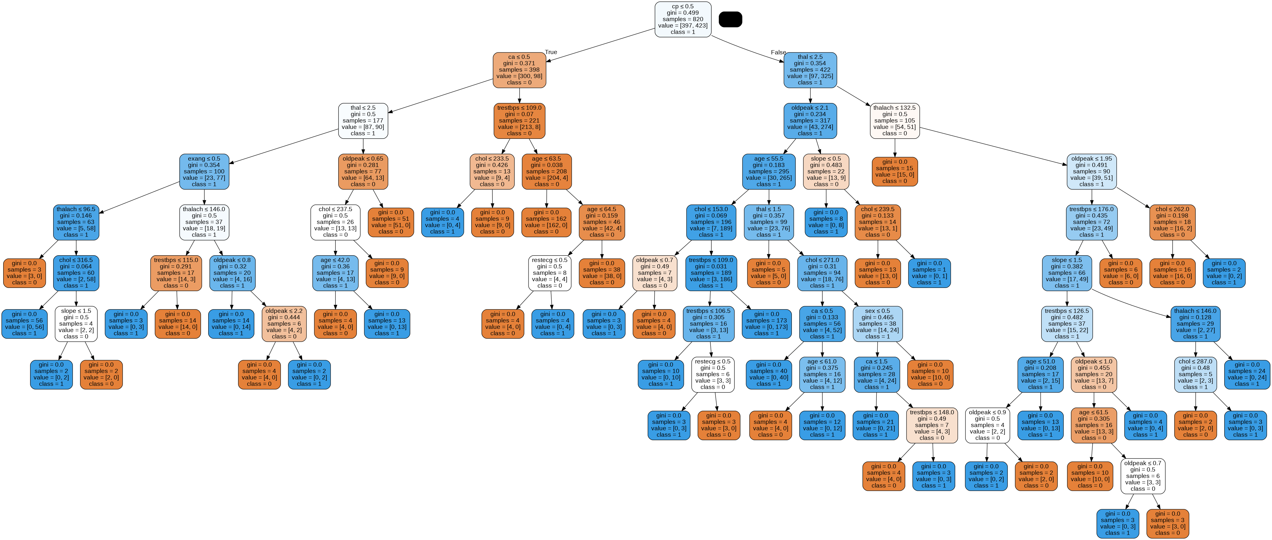

Slide 10
Conclusion

Slide 11


